Slide 1
Reinforcement Project
Dataset Used: Superstore sales
Course:
Data Analytics and Data Science
Batch: July 2025
Name:
Krishna Kumar
Date: 28-08-2025

Slide 2
Project Objective
To review sales data to ﬁnd trends, understand how well products are selling, and provide useful ideas for business improvements.
Key Goals
Examine sales patterns across different time periods.
Highlight top-selling products and the most effective sales platforms.
Assess how returns and discount strategies affect overall revenue.

Slide 3
Data Description and Preparation
Overview:
Order ID / Sale ID – Unique identifiers for transactions
Order Date – Timestamp of each purchase
Product Type / Category / Sub-Category – Classification of items sold
Sales, Quantity, Discount, Profit – Financial metrics for each sale
Customer and Region Info – Including city, state, and segment
Shipping Details – Ship mode and shipping date

Slide 4
Removed duplicate records
Handled missing values using appropriate imputation or removal
Standardized date formats and numerical fields
Converted categorical fields for consistency (e.g., product types, regions)
Validated data types for accurate analysis
Data Cleaning Steps

Slide 5
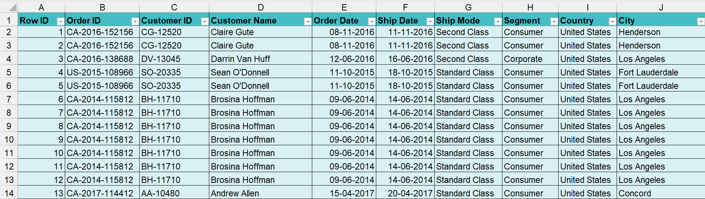
Clean Dataset After Manipulation

Slide 6
Key Metrics Calculation and Data Analysis
KPI’S USED AND ITS FORMULA
[=sum(@Sales column)] [=average(@Sales column)] [=sum@discounts column]
[=COUNTA@customer_ID]
Total sales (Gross):
Average sales per order:
Total Discounts:
Total No. of Orders:
Order Counts by (Cat. & Segment)
Total Discount by (Category)
[=COUNTIF(@Segment,"Criteria")]
[=SUMIF(@Category,“Criteria", @Discount)]

Slide 7
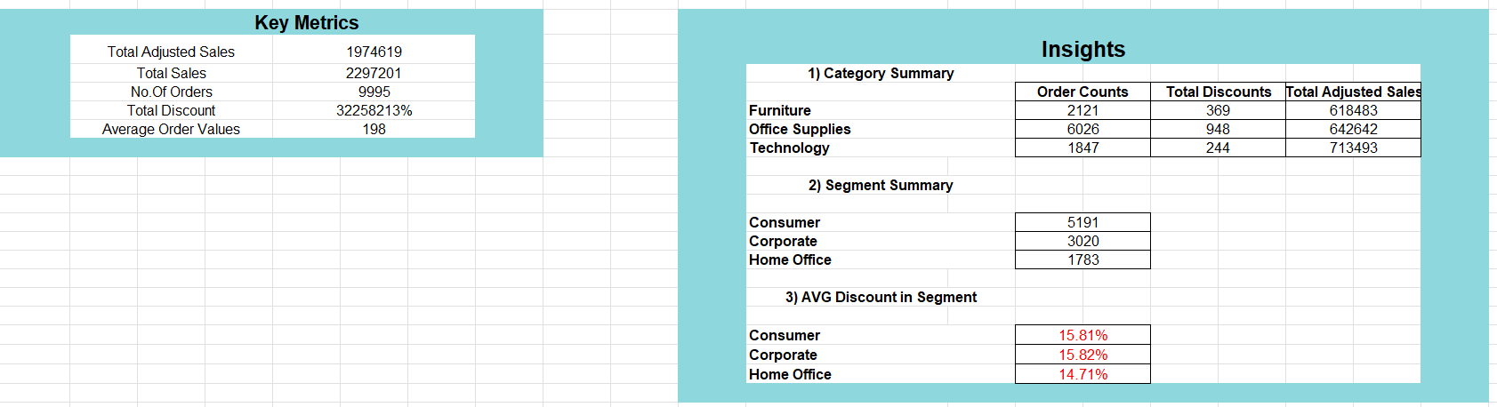
Key Metrics Calculation and Data Analysis

Slide 8
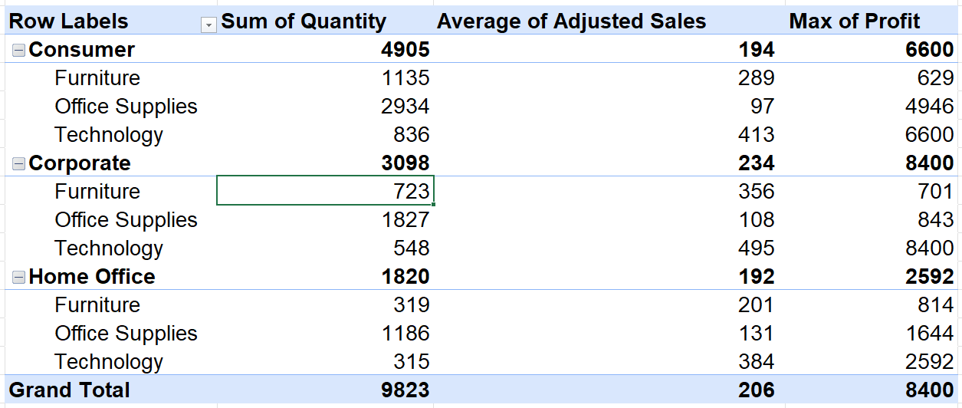
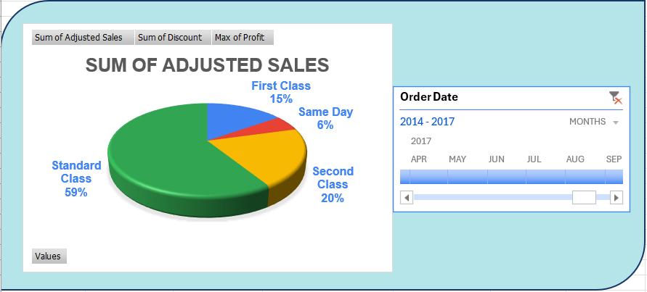
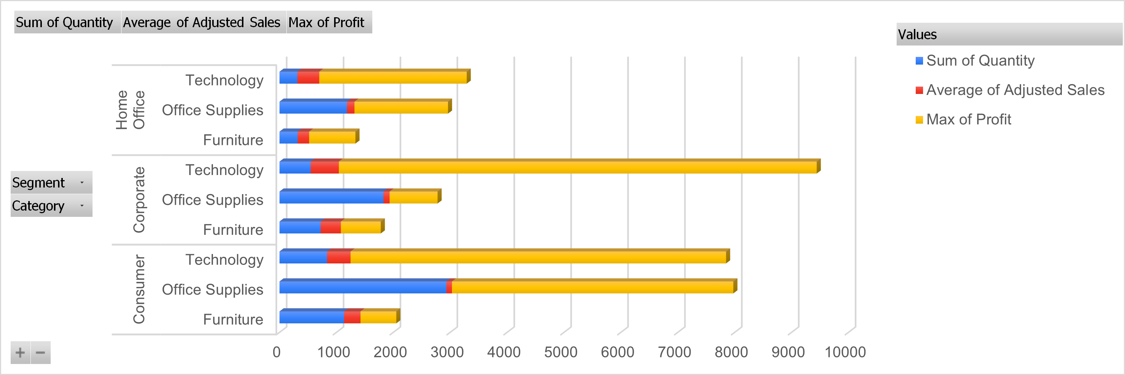
Pivot Tables and Pivot Charts

Slide 9
Dashboard Overview
Dashboard was created to present key sales insights in a clear, interactive, and user-friendly format. It enables quick decision-making and real-time data exploration for stakeholders.
Key Components:
KPIs: Displays vital metrics such as Total Sales, Average Sales/order, Top Performing Category and Average Sales
Slicers: Interactive ﬁlters for dimensions like Segment and Category, allowing users to drill down into speciﬁc segments

Slide 10
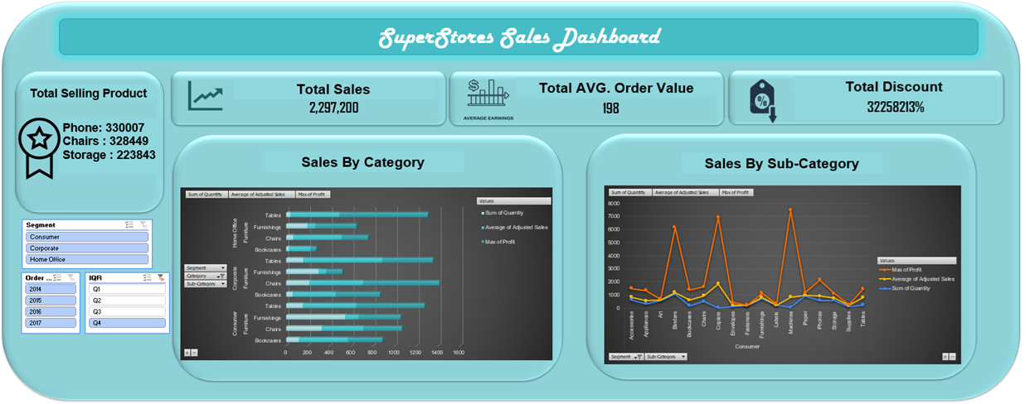
DASHBOARD

Slide 11
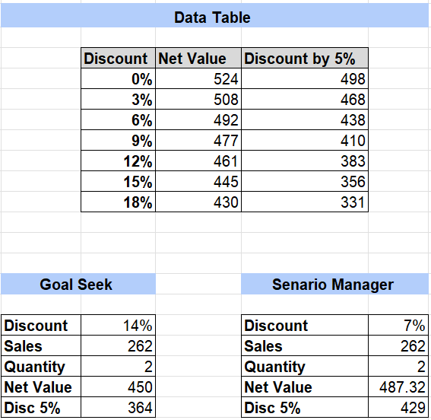
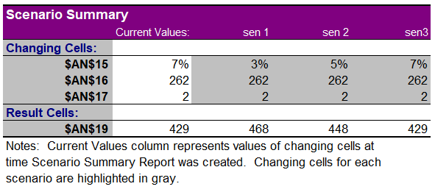
What-If Analysis and Goal Seek
FORMULA USED:
Net Value Calculation:
=Sales*(1-Discount)*Quantity
5% Decreased Discount:
=Netvalue*((1-Discount)-0.05)

Slide 12
Insights & Recommendations
Increasing Sales Trend: Sales increased from 2014 to 2017, with notable peaks in November and December due to holiday shopping.
Profit Stability: Proﬁts align with sales trends but are more stable, indicating varying proﬁt margins.
Key Figures: Highest sales in November 2017 (118,447.82); lowest in February 2014 (4,519
.892); signiﬁcant loss in January 2015 (3,281.007).

Slide 13
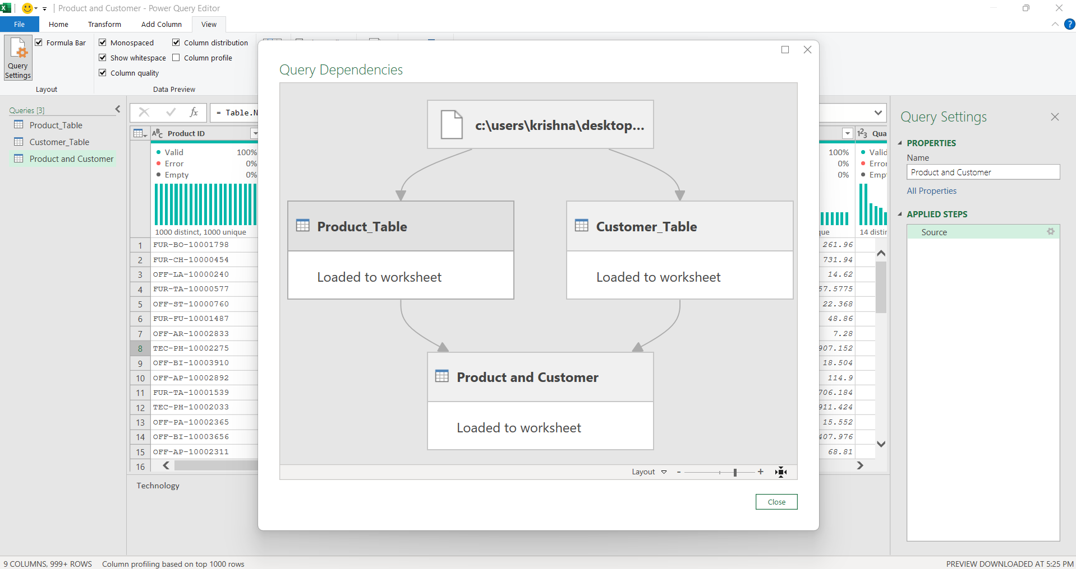
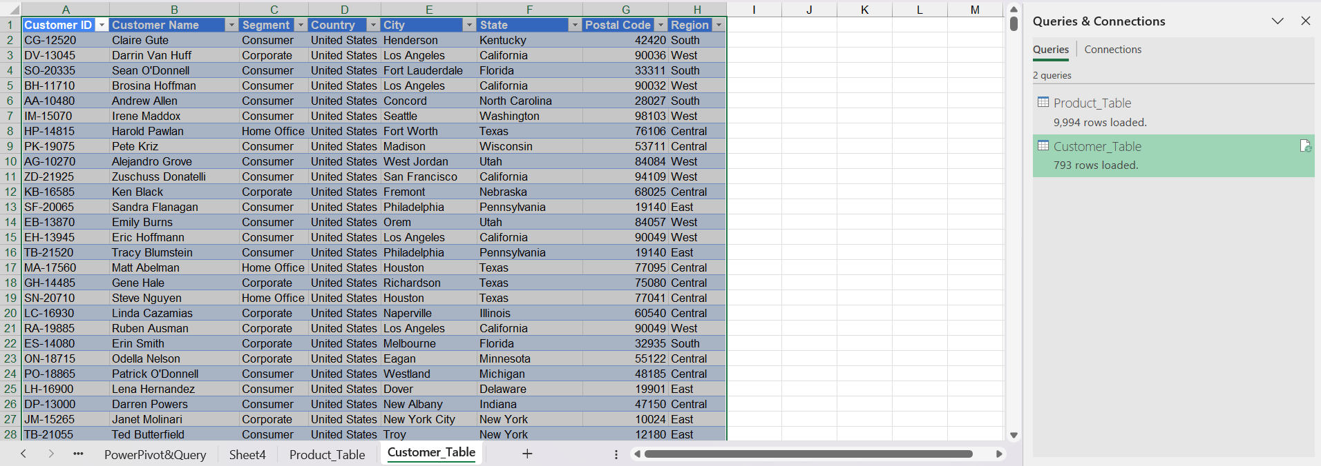

Power Pivot & Power Query

Slide 14
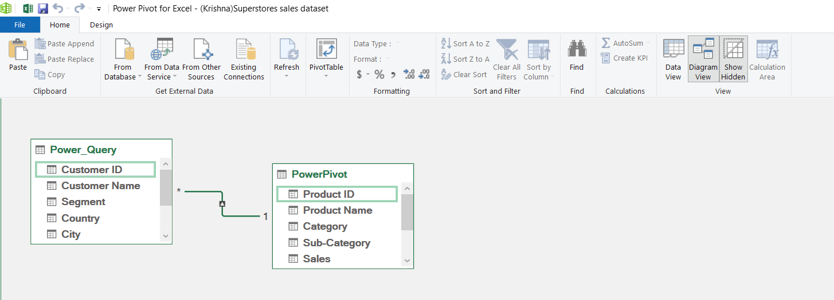
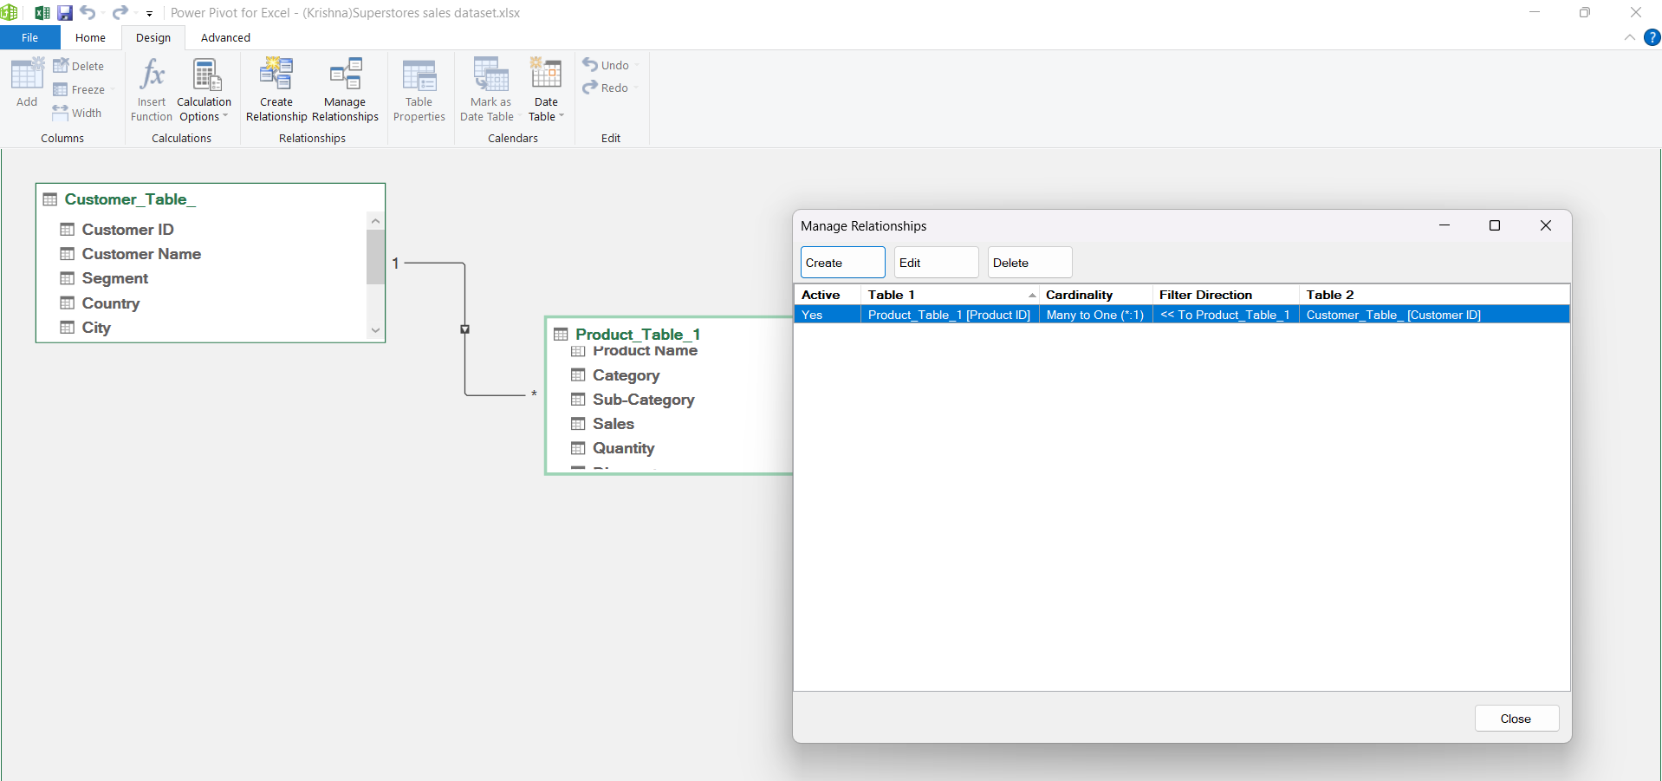
Power Pivot & Power Query

Slide 15
THANK YOU

